Slide 1
UX - QHO428

Slide 2
UX
QHO428
Technical /Content Requirements and Task Modelling
Week 2

Slide 3
Module Learning outcomes
On successful completion of this module, you will be able to
Identify the key component of User Experience context, including understanding the technology and stakeholders.
Interpret digital product or service requirements including business, technical and potential user sources and define appropriate measures of success, including goals, objectives and key performance indicators (KPIs).
Explain issues with usability and effectiveness of digital products and services and to identify areas for improvement.
Describe digital product usability, accessibility and other legal requirements.
Interpret user types and their goals, behaviours and pain points using appropriate design artefacts to inform the design process.

Slide 4
Assessment
Assignment : 100% - Individual written report

Slide 5
Week 2- Objectives
Technical Requirements
Content Requirements
Scenarios
Task Analysis
Prioritise (MoSCoW)

Slide 6
The Scope Plane
The Scope plane takes finding of the Strategy plane and aligns them
  It ensures we know what we are building
  Aligning our expectations against the user’s
Requirements allow us to lay out the deliverables and objectives
  Setting out the entire scope mapped out for the project
Establish what you are building – ensure everyone understands
  Identify requirements, ensure they match user needs
  Not possible user needs
  Set out a timeline and stop scope creep
We move from why are we making this product to:
  What are we going to make
Notes:
Based on evidence we now need to clearly set out our objectives for the development of the product – our evidence from the Strategy plane should provide significant evidence to support or deny early assumptions. The final product must stop being a nebulous construct in a senior stakeholders mind and reach a concrete framework to take towards development.

Slide 7
Technical Requirements
Traditional requirement specifications can be enhanced with UX:
  Feature requirements can be based on information collected during the user research phase
  User research complements market research data and other sources of product development information.
    Basing feature requirements on actual user data
    Reducing the risk of investing resources in unwanted features
    Increases the likelihood of adding features that will drive sales
  UX-specific requirements can be added to the specification
    Adding UX requirements becomes a business priority
    Alongside other product attributes
    Ensuring UX improvements are delivered when the product ships
Notes:
Traditional requirement specifications can be enhanced with UX information in two main ways:
Feature requirements can be based on information collected during the user research phase. Here, user research complements market research data and other sources of product development information. Basing feature requirements on actual user data collected during research reduces the risk of investing resources in unwanted features and increases the likelihood of adding features that will drive sales.
UX-specific requirements can be added to the requirement specification. By adding UX requirements, UX becomes a priority alongside other product attributes and UX improvements are delivered when the product ships.

Slide 8
Content Requirements
Content requirements refer to text, images, audio and text
  These pieces of content work together to fulfil a requirement
    e.g. a piece supporting a film may require text, image/video and links to external ratings
  At this point we care about the content – not the format
    Never get caught up by this – that is for the surface phase
  As we consider data consider size and performance
    Especially important for mobile users
  Identify who is responsible for content
  Identify the frequency of updates
    Is this static, how often does it change, who changes it
  This will be tedious but we have to do it.

Slide 9
Content
One of the first steps to effective IA is content analysis determine:
  Content you have
    Learn what you have, avoid duplication
  Content you need
    For each task analyse content required, who is responsible for it
    Who will provide content
  Communicating about content
    Build a content spreadsheet
    Colour code according to popularity
  Content planning
  Classification schemes

Slide 10
Content you have
Learning what content you have will help you:
  Understand the subject
    If you’re working on a new site, or a subject you don’t have much experience with
  Look at it with fresh eyes:
    A great refresher and gives you a chance to look at your content
  Clean up:
    Clean up old, out-of-date and inaccurate content.
  Migrate it:
    You need to know what you have so you don’t lose anything in the migration.
  Manage progress:
    Keep track of things like what content has been rewritten

Slide 11
Conduct a content inventory
To manage content you will need to perform some form of audit:
  Full content inventory – which includes all
    Page, downloadable objects e,g, PDF files, documents,
    Embedded objects, such as video or audio other content
      In blogging sites this may include reader comments
  Partial content inventory
    This collects information for a number of levels of the site
      Though it may show some parts of the site in more detail.
    It is a good practical approach for very large sites
  Content audit
    Is a sample across the site.
    It may collect details for the first couple of levels of a site
      Then details for different page types in each section.

Slide 12
Content you Need
Whether working on a new design or launching think content
  The content you choose should meet
    The needs of the people using your product
    Help achieve your project goals
Consider approaching content creation in the following ways:
  Current behaviours
  User research
  Your own ideas for content

Slide 13
Current Behaviour
Examine what users are currently viewing and doing
  From site metrics
  Competitor analysis
Do not just focus on immediate data
  Check what happens at different times of the year
  When new content is added – does it peak and not get used again?
Prioritise popular content – it becomes popular because of users
  Provide better links to existing and related content
  Investigate social networking trends
    Use verbs and action from the research phase

Slide 14
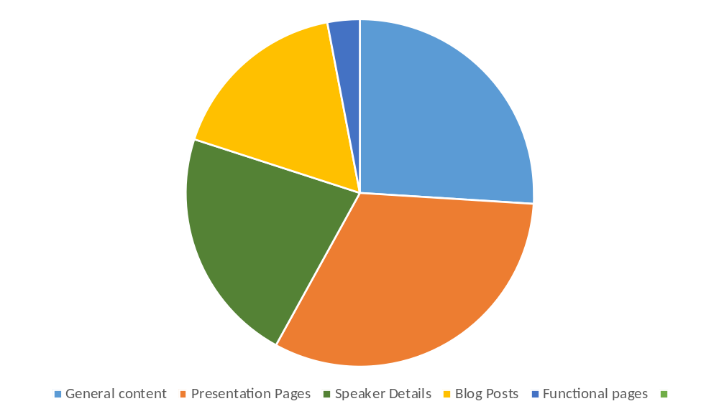
Content Planning
Build a spreadsheet of content
  Use analytics to investigate who is doing what
  Categorise content
  Understand popularity

Slide 15
Class Activity 1 - Group Discussion – Student Management System
*** Student Management System (SMS)) is a software and used By students , academic and admin departments to perform day to day activity
Identify the following from SMS - (make assumptions)
  The landing page for SMS app
    what should be on it and what will change
  Consider a page showing students attendance and identify
    Content, and frequency of change
  Consider the SMS information page, what content is needed for tutors and students
    Who will use it and why

Slide 16


Scenarios
Scenarios describe the stories and context behind why a specific user or user group comes to your site
They note the goals and questions to be achieved and sometimes define the possibilities of how the user can achieve them on the site
Scenarios are critical both for designing an interface and for usability testing.
Notes:
Scenarios describe the stories and context behind why a specific user or user group comes to your site. They note the goals and questions to be achieved and sometimes define the possibilities of how the user(s) can achieve them on the site.
Scenarios are critical both for designing an interface and for usability testing.

Slide 17

Scenario Types
Goal or task based scenarios
Elaborated scenarios
Full scale task scenarios
Notes:
Goal- or Task-Based Scenarios state only what the user wants to do. Do not include any information on how the user would complete the scenario. These scenarios are useful in helping to define your site architecture and content. You should give these types of scenarios to users in a usability test. It gives them a reason and a goal for going to the site, but it lets them show you how they would use the site to accomplish that goal.
Example: A parent is worried about a ten-year old refusing to drink milk and wants to know if it really makes a difference that the child is getting very little calcium.
Example: You are traveling to Seattle for your job next week and you want to check on the amount you can be reimbursed for meals and other expenses.
Elaborated Scenarios give more user story details. These details give the Web team a deeper understanding of the users and users’ characteristics that may help or hinder site interaction. Knowing this information, the team is more likely to develop content, functionality, and site behavior that users find comfortable and easy to work with.
Example: Mr. and Mrs. Macomb are retired schoolteachers who are now in their 70s. Their Social Security checks are an important part of their income. They've just sold their big house and moved to a small apartment. They know that one of the many chores they need to do now is tell the Social Security Administration that they have moved. They don't know where the nearest Social Security office is and it's getting harder for them to do a lot of walking or driving. If it is easy and safe enough, they would like to use the computer to notify the Social Security Administration of their move. However, they are somewhat nervous about doing a task like this by computer. They never used computers in their jobs. However, their son, Steve, gave them a computer last year, set it up for them, and showed them how to use email and go to websites. They have never been to the Social Security Administration's website, so they don't know how it is organized. Also, they are reluctant to give out personal information online, so they want to know how safe it is to tell the agency about their new address this way.
Full Scale Task Scenarios include the steps to accomplish the task. A full-scale scenario can either report all the steps that a specific user currently takes to accomplish the task or it can describe the steps you plan to set up for users in the new site. Scenarios at this level are very similar to use cases, but they lay out the steps from the user's point of view rather than from the website's point of view. They explain how the site supports the goal-oriented scenarios that you started with.

Slide 18
Using Scenarios in Website Design
It is impossible to write down every scenario that every user has for visiting your website
Scenarios can be used as the stories behind why the particular user would come to your website
  What does the user hope to accomplish by visiting the website?
  What characteristics of the user might help or hinder his or her site interaction?
You should focus on users and their tasks rather than on your site's organization and internal structure
Notes:
Using Scenarios in Website Design
It is impossible to write down every scenario that every user has for visiting your website. Instead, before you start to put the site together, write down 10 to 30 of the most common reasons that users have for visiting or tasks that users want to do.
Scenarios can also work together with personas by serving as the stories behind why the particular persona would come to your website. What does the persona hope to accomplish by visiting the website? What characteristics of the persona might help or hinder his or her site interaction?
You should focus on users and their tasks rather than on your site's organization and internal structure. As a result, you will know what content the site must have and how it should be organized.

Slide 19
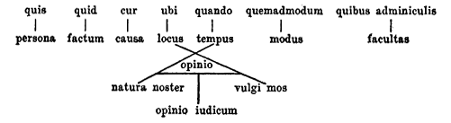
Scenario Mapping
A UX scenario is a story about a user carrying out a specific task
  Scenarios can be very detailed, all the way to very high level
  As a minimum they should at least outline the usages:
    who
    what
    when
    where
    why
    how
Notes:
As Victorinus, a student of Plato, postulated in the first century BC the basis of information gathering questions follow the five W (plus a H). Scenarios can be very detailed, all the way to very high level but should at least outline the ‘who’, ‘what’, ‘when’, ‘where’, ‘why’, and ‘how’ of the usage. They typically outline a user journey (usually a quantified persona) through an activity or feature.

Slide 20
How to perform Scenario Mapping
We are attempting to analyse the steps the user will take to complete a task. To achieve it we follow the below approach:
  Outline the Scenario and user(s)
  Discuss and work out the steps the user would take and identify
    What the User Does
    Resolve questions, queries and assumptions
    Follow through on flaws and issues with suggestion
    Revisit
  Repeat for each user task
Notes:
As a group you’ll want to walk through all the steps that you envisage a user taking to carry out their task identify:
What the user does. Remember to focus on what happens, not necessarily how it happens. For example, Paul brings up a larger image of a bouquet of flowers that he thinks his Mum would like.
Any comments or information that you feel is important at this step. For example, you might want to make a note that there might be alternative images available for a bouquet of flowers, such as a front and side shot.
Any questions or assumptions that arise are this step that you’ll want to resolve. For example, will the images for flowers all be the same size and aspect ratio?
Any ideas or good suggestions that people have. For example, it would be good to allow Paul to zoom in on an image so that he can see the bouquet of flowers in more detail.

Slide 21
Class Activity 2 - Create your Own Scenarios
In groups, write as many scenarios as you can think of for the SMS app that you worked on previously(Class Activity 1 )

Slide 22
Task Modelling
A task models are an important design deliverable
  It shows what users do
  The behaviour it adopts
  Requirement specification at each stage
Building a product around these findings is more successful
  We try to ensure that we do what the user wants when they want is
  Matching user expectation against proposed system behaviour
  Giving focus and direction to the experience you need to create
This can be applied to a single task and/or the whole experience

Slide 23
What makes a good task model?
Task models show what a user needs and expects to do
  They are goal based
    Focusing the team on how the user behaves
  They enhance a process with rich information:
    Behaviour Patterns
    Content requirements
    Persona involved
    Users emotions
    Content strategy
Notes:
Personas and task models sit alongside each other and feed off the same types of research, so for efficiency the two can be developed side by side, which also allows you to consider different task models based on the personas. Competitor benchmarking, personas, and task models are often covered in the same workshop because they usefully feed off each other.

Slide 24
How to Perform Task Analysis
To perform task analysis we need to identify the following:
  The Goal
    What is the user ultimately trying to do?
  The order of the tasks
    The flow of tasks to reach the goal
    For longer tasks this can be grouped into phases or sub tasks
  User Behaviour
    User behaviour shows a users movement between tasks
      Identify:
        Direct connections
        Controlled evaluations
        Complex evaluations
  Emotional Needs
    What is driving the users behaviour?
Notes:
Complex evaluation: Complex evaluations can be found in almost every project. This is where a user requires several different, and often unrelated, needs to be fulfilled to complete a goal. When booking a vacation, for example, users evaluate dates, locations, activities, and cost. It is likely that they will have some specific requirements (such as it must have a swimming pool or it must not be too close to a main road). Their ultimate emotional goals might be to have a relaxing break. Uncovering and understanding this information gives guidance to how information is displayed, the feel you want to convey, and the deeper content that needs to be available.

Slide 25
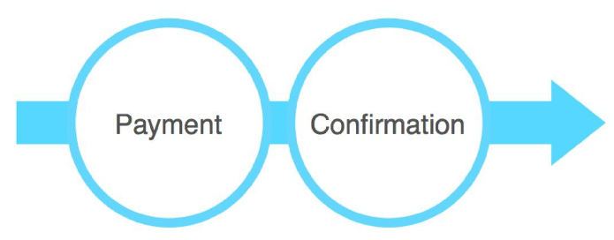
Direct Connections
Direct connection: One task leads on to the next
  For example, a user has completed their holiday booking
Only provide direct flows and connections when appropriate
  Using where users don't want them will lead to a poor experience
  They will feel that they are being forced down blind alleys
Notes:
Direct connection: One task leads on to the next. For example, a user has completed their holiday booking, clicked the submit button, and a confirmation page appears.

Slide 26
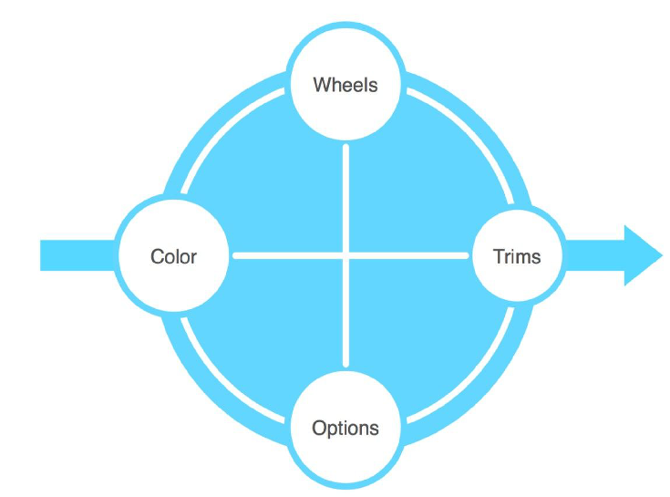
Controlled Evaluation
If the user explorers a well defined product or service it is controlled
The interface and navigation focus on allowing a user to perform the task
Notes:
Controlled evaluation: A user wants to explore aspects of a well-defined product or service. For example, let's say you are buying a car and want to evaluate combinations of different wheels, engines, trims, and options. The interface and navigation can focus just on allowing you to do these things in a controlled environment until you reach an outcome.

Slide 27
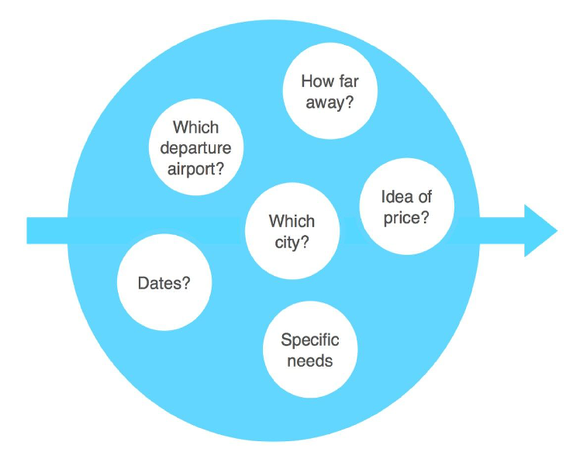
Complex Evaluation
Complex evaluations occur when users have unrelated needs
  For example when booking a holiday the user may evaluate:
    Dates
    Locations
    Activities
    Cost
  Understanding the emotional goal is key

Slide 28
Emotional Needs
What behaviour is driving the user?
  e.g. When buying a new car the response from friends may top the specification
Who or what are their influences?
  Are there other users involved and what other factors influence?
Content requirements?
  Through research identify what media is needed at different points in the journey
Existing barriers
  Have you identified other reasons users may not complete tasks?

Slide 29
What do Task Models Communicate?
Task models tell a story about your users
  Becoming a reference point throughout project design & development
Book tickets
Confirmation
Image of
participant
in user
research
Name, Age
Quote from user research
Must have…
“Quote from a participant interviewed during research”
Departure airport
Date / time
Price
Note note note note note note note note note
Specifics

Slide 30
Example - Book a cheap flight to New York in July
“There are a few airports I could fly from”
Departure airport
“Normally I just want to book the flights and none of the shows or museum trips, but I do like to see what’s going on”
Destination
Date / time
Price
Book tickets
Confirmation
“I can be flexible with dates, but I’d prefer not to get up too early. And I need to Liaise with my sister in New York”
“I’m not necessarily after the cheapest, it’s a combination of things”
“I won’t look at the email again until just before I travel”
Specifics
“I must have an aisle seat”
Image of
participant
in user
research
Katharine, 29
I want a hassle free trip to New York to spend time with my sister and go shopping.
Must have an aisle seat, must not get up to early.
Other people are often involved in the date / time discussion.
Users need to easily move between these different options in order to make an informed and confident decision.

Slide 31
Class Activity 3 - Exercise – Task Analysis
In groups, take two of the scenarios you built earlier in Class Activity 2 and create task models

Slide 32
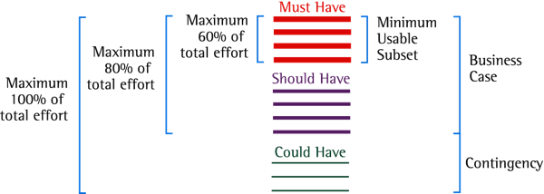
Prioritise - MoSCoW
You will have many tasks – wit will be necessary to prioritise them
  The MoSCoW method can help with this:
    Must Have
    Should Have
    Could Have
    Won’t Have this time
Apply prioritisation based around mapped scenarios and user personas

Slide 33
MoSCoW(2)
Must Have - these provide the Minimum Usable Subset of requirements:
  This may be defined using some of the following:
    Cannot deliver on target date without this
    No point in delivering on target date without this
    Not legal without it
    Cannot deliver the Business Case without it
Should Have - Important but not vital
  May be painful to leave out, but the solution is still viable
  May need some kind of workaround
    e.g. management of expectations, some inefficiency

Slide 34
MoSCoW(3)
Nice to Have
  Wanted or desirable but less important
  Less impact if left out (compared with a Should Have)
Will not have this time:
  Requirements which the project team has agreed it will not deliver.
  Ensure they are recorded in the Prioritised Requirements List
  This helps clarify the scope of the project
  This helps to manage expectations
    that some requirements will simply not make it

Slide 35
Class Activity 4 - Exercise – Prioritisation
Take the scenarios you outlined earlier in the exercise and align them through MOSCOW prioritisation.

Slide 36
Review
The scope planes takes the findings from the strategy plane
Then applies some more formal analysis to the data
  Setting deliverables, ensuring processes are understood

Slide 37
What you should know
Technical Requirements
Content Requirements
Scenarios
Task Analysis
Prioritise (MoSCoW)

Slide 38
Recommended Books
Unger, R. and Chandler, C., 2012. A project guide to UX design. Berkeley, Calif: New Riders.
Garrett, J., 2011. The elements of user experience. Berkeley, CA: New Riders.

